Slide 1
Web Application -III
Waqar Yar

Slide 2
Topics Covered today
Threads.
Thread Safe Objects
Request Dispatcher
How to manage a Request Object.
Usage of each type of Object.

Slide 3
Attribute Scopes
There are three attribute scopes:
1-Context
2-Request
3-Session

Slide 4
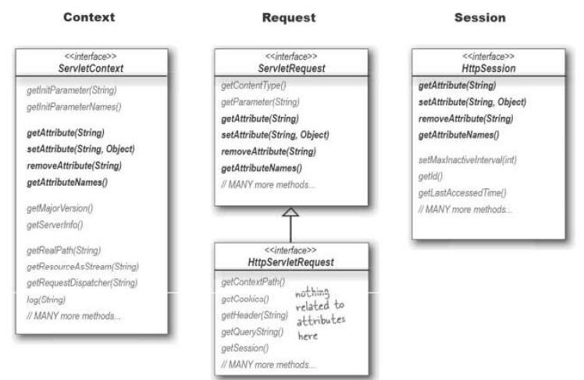

Slide 5
Threads
public class HelloThread extends Thread {
public void run() {
System.out.println("Hello from a thread!");
}
public static void main(String args[]) {
(new HelloThread()).start();
}
}

Slide 6
Synchronized Methods
public class SynchronizedCounter {
private int c = 0;
public synchronized void increment() {
c++;
}
public synchronized void decrement() {
c--; }
public synchronized int value() {
return c; }
}

Slide 7
Synchronized Statements
public void addName(String name) {
synchronized(this) {
lastName = name;
nameCount++;
}
nameList.add(name);
}

Slide 8
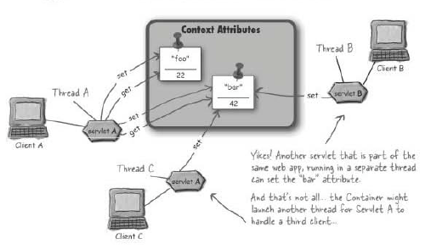
Is Context Thread safe?

Slide 9
Is Context Thread safe?
Every servlet has access to the Context object.
Any servlet can update the value of the attributes.
Each servlet is running in a separate thread.

Slide 10
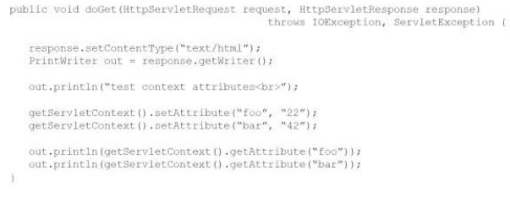
Is Context Thread safe?

Slide 11
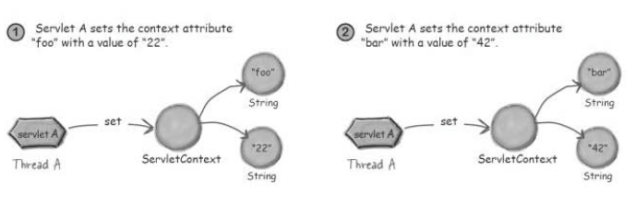
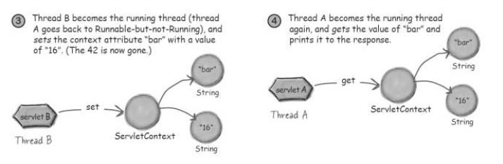

Slide 12
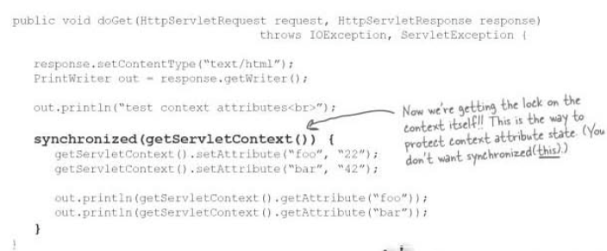
How to make Context Thread Safe?

Slide 13
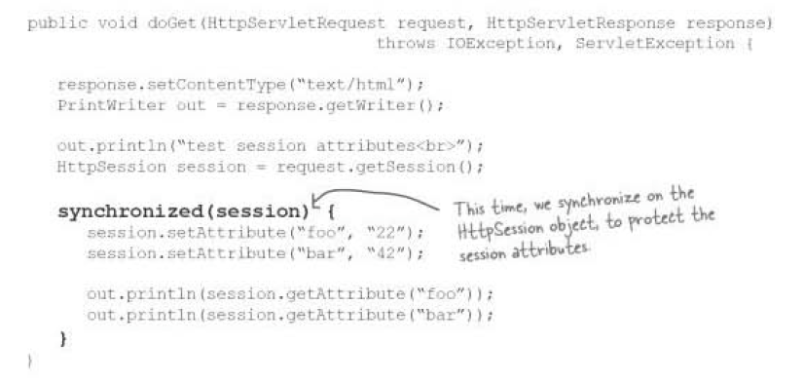
How to make Session Thread Safe?

Slide 14
RequestDispatcher
We can get a RequestDispatcher from the following two objects:
1-Context
2-Request.
RequestDispatcher has the following two methods:
1- forward()
2- include()

Slide 15
Getting a RequestDispatcher
Getting a RequestDispatcher from a ServletRequest:
If the path starts with a forward slash, the container sees that as a “starting from the root of this wab application”.
If there is no forward slash, its considered relative to the original request.

Slide 16

Getting a RequestDispatcher
Getting a RequestDispatcher from a ServletContext:
The path must start with a forward slash.
A relative path cannot be specified.
Using a RequestDispatcher:

Slide 17
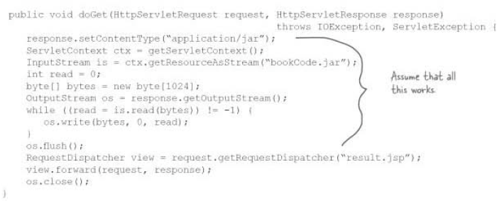
How to manage a Request Object

Slide 18
